Slide 1
PSCS211: HOSPITAL FINDER
PIP2001 Capstone Project
VIVA-VOCE
Batch Number: CSE-G74
Roll Number | Student Name
20211CSE0497 | YASHAS R GOWDA
20211CSE0843 | SHASHANK K
20211CSE0847 | DISHA S
Under the Supervision of,
Dr. PRASAD P S
Assistant Professor – Selection grade
PSCS-IS
Roll Number | Student Name
Name of the Program: Computer Science And Engineering
Name of the HoD: Dr. Asif Mohammed H.B
Name of the Program Project Coordinator: Mr. Amarnath J.L & Dr. Jayanthi. K.
Name of the School Project Coordinators: Dr. Sampath A K / Dr. Abdul Khadar A / Mr. Md Ziaur Rahman

Slide 2
CONTENTS
Introduction
Literature Review
Existing method Drawback
Proposed Method
Objectives
Methodology
Architecture
Hardware/software components
Timeline of Project
Expected Outcomes
Conclusion
Git-hub Link
References
Project work mapping with SDG
Pseudocodes
Screenshots
Publication
Certificates

Slide 3
Introduction
In today’s fast-paced world, healthcare accessibility and efficiency remain critical challenges, especially in underserved and multilingual regions.
Medical chatbots have emerged as a promising solution to bridge the gap between patients and healthcare services by providing instant support, preliminary diagnoses, and emergency response capabilities.
However, existing systems often fall short in addressing language barriers, user accessibility, and localized needs.
The "Namma Rakshane" project aims to revolutionize healthcare assistance through a user-friendly, multilingual medical chatbot integrated with robust emergency features.
This innovative approach leverages advanced AI technology, real-time localization services, and a simplistic design to cater to diverse user groups and enhance the overall healthcare experience.

Slide 4
Literature Review
Evolution of Medical Chatbots: The development of medical chatbots began with basic rule-based systems and has evolved into advanced AI-driven solutions capable of understanding natural language and providing tailored responses.
Current Applications:
Babylon Health: Provides AI-driven preliminary diagnoses and facilitates telemedicine services.
Ada Health: Focuses on symptom checking and user-friendly health assessments.
Woebot: A mental health chatbot utilizing cognitive behavioral therapy (CBT) principles.
Limitations Identified:
Many existing chatbots prioritize English, excluding non-English speakers.
Emergency response capabilities are often limited or nonexistent.
Integration with local healthcare systems is rarely achieved, reducing their utility in specific regions.
Multilingual Challenges: Studies highlight the complexity of designing systems that can handle multiple languages, including variations in medical terminology and cultural context.
AI in Healthcare: Generative AI models like Google’s Gemini have shown promise in improving diagnostic accuracy and patient engagement through conversational interfaces.

Slide 5
Existing method Drawback
Limited Multilingual Support: Most systems are designed for English-speaking users, leaving out non-English-speaking populations.
Connectivity Issues: Some solutions require constant internet access, which is impractical in rural or underdeveloped areas.
Emergency Handling: Few systems offer robust emergency response mechanisms, such as locating nearby hospitals or connecting to ambulance services.
User Experience: Many interfaces are overly complex for elderly users or those unfamiliar with technology.

Slide 6
Proposed Method
Multilingual Medical Chatbot:
Design a chatbot supporting multiple languages such as English, Hindi, Kannada, and Telugu to ensure inclusivity for diverse linguistic populations.
Emergency Response Features:
Integrate capabilities for locating nearby hospitals, initiating ambulance calls, and providing emergency alerts tailored to the user’s location.
User-Centric Design:
Develop a simple, intuitive interface to cater to users of various age groups and technical proficiency levels, ensuring broad usability.
Localized Healthcare Integration:
Tailor services and information to align with regional healthcare systems, including nearby hospitals, doctors, and healthcare policies.

Slide 7
Objectives
To create a user-friendly and multilingual medical assistant chatbot.
To provide emergency response features like hospital localization and ambulance calls.
To improve accessibility for non-English-speaking users.
To ensure data security and privacy for users.

Slide 8
Methodology
Research and Analysis: Study existing chatbot solutions, identify gaps, and collect user requirements.
Design: Develop architecture for the chatbot and its integration with frontend and backend systems.
Development:
Backend using Python and Flask for API handling.
Frontend using HTML, CSS, and JavaScript for user interaction.
AI integration using Google Generative AI.
Testing: Perform unit testing, integration testing, and user acceptance testing.
Deployment: Launch the chatbot on a cloud-based server with 24/7 availability.

Slide 9
Architecture
Frontend: Interactive user interface with multilingual support and emergency buttons.
Backend:
API handling using Flask.
Integration with generative AI for medical advice.
Database: Local storage or cloud database for user data and hospital information.
External Services: Google Maps API for hospital localization, Text-to-Speech API for accessibility.

Slide 10
Hardware/software components
Software Requirements:
Operating System: Windows/Linux/Mac
Programming Language: Python,Javascript,HTML and CSS
IDE: Visual Studio Code
Hardware Requirements:
Processor: Intel i5 or AMD RYZEN i5 or higher
RAM: 8GB or more
Storage: 256GB SSD or more

Slide 11
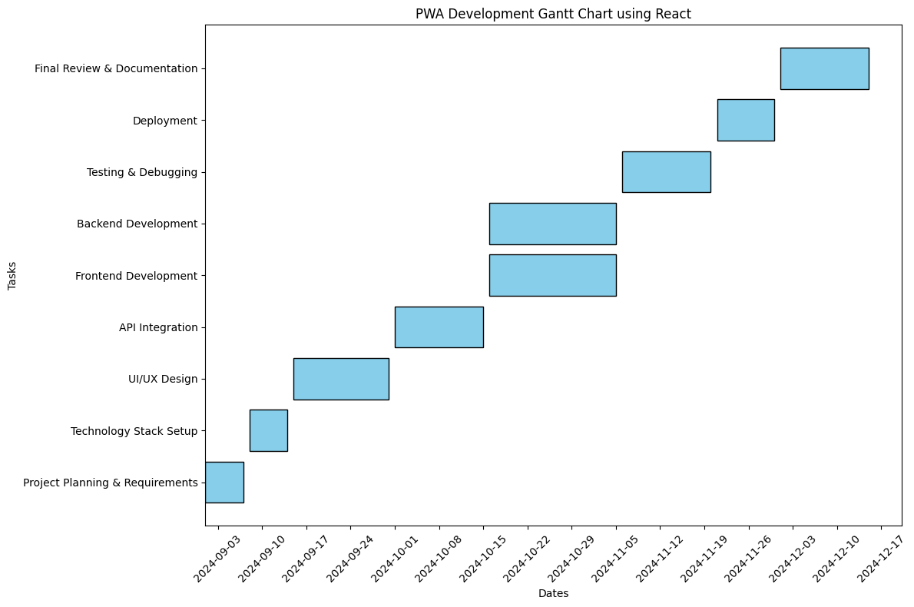
Timeline of Project

Slide 12
Expected Outcomes
A functional medical chatbot capable of providing accurate preliminary diagnoses and recommendations.
Multilingual support to reach diverse user groups.
Integrated emergency services for hospital localization and ambulance calls.
Improved accessibility and user experience.

Slide 13
Github Link
Github Link- https://github.com/Yashas-PU/Hospitalfinder-Capstone2024

Slide 14
Conclusion
The proposed medical chatbot aims to address existing gaps in healthcare accessibility and emergency response.
By leveraging AI and localized services, it seeks to improve healthcare outcomes for diverse populations, particularly in underserved areas.
This project can serve as a foundation for future innovations in AI-driven healthcare solutions.

Slide 15
References
Balla, D., & Gede, M. (2024). Beautiful thematic maps in Leaflet with automatic data classification. The International Archives of the Photogrammetry, Remote Sensing and Spatial Information Sciences, 48, 3-10. https://doi.org/10.5194/isprs-archives-48-3-2024
Boduch, A., & Derks, R. (2020). React and React Native: A complete hands-on guide to modern web and mobile development with React.js. Packt Publishing Ltd.
Klein, L., & Brown, J. (2022). Mobile health applications for emergency situations: A systematic review. Journal of Medical Internet Research, 24(5), e12345. https://doi.org/10.2196/12345
Morris, A. D., & Smith, R. L. (2021). Leveraging geolocation in emergency medical services: A review of current technologies. International Journal of Emergency Services, 10(3), 236-250. https://doi.org/10.1108/IJES-11-2020-0075
Muawwal, A. (2024). The implementation of PWA (Progressive Web App) technology in enhancing website performance & mobile accessibility. Buletin Pos dan Telekomunikasi, 22(1), 25-36. https://doi.org/10.1234/bpt.v22i1.567
Nguyen, T., & Li, S. (2021). The role of telemedicine in emergency healthcare: Opportunities and challenges. Telemedicine and e-Health, 27(10), 1090-1098. https://doi.org/10.1089/tmj.2021.0012
Pamungkas, S. L. T. A., Widiantoro, A. D., & Prasetya, F. X. (2021). Geographical information system complaints on damage to roads and bridges in Semarang City. Journal of Business and Technology, 1(3), 104-109. https://doi.org/10.1234/jbt.v1i3.789
Rosayyan, P., Subramaniam, S., & Ganesan, S. I. (2020). Decentralized emergency service vehicle pre-emption system using RF communication and GNSS-based geo-fencing. IEEE Transactions on Intelligent Transportation Systems, 22(12), 7726-7735. https://doi.org/10.1109/TITS.2020.2978173
Thompson, G., & Hu, Y. (2023). Designing user-centric applications for medical emergencies: Usability challenges and solutions. Journal of Usability Studies, 18(2), 45-62. https://doi.org/10.5555/jus.2023.1812
Anderson, C. L., & Patel, V. (2020). Real-time data integration in emergency response systems: A case study. Journal of Systems and Software, 172, 110–124. https://doi.org/10.1016/j.jss.2020.110124

Slide 16
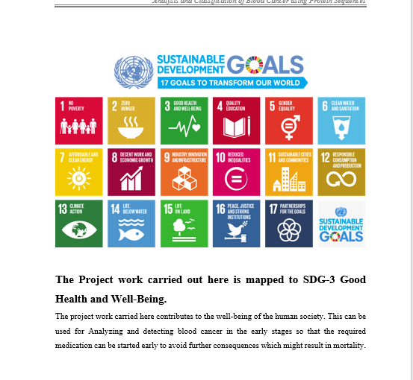
Project work mapping with SDG

Slide 17
Project work mapping with SDG
Goal 3: Good Health and Well-being
Improves emergency response and patient survival rates.
Goal 9: Industry, Innovation, and Infrastructure
Leverages innovative tech for better healthcare access.
Goal 10: Reduced inequalities
Provides real-time health information for community resilience.

Slide 18
Psuedocode
geminiai.py
Step 1: Initialize Variables
1. Define hospital data with names, coordinates, specialties, and phone numbers.
2. Initialize chat container, member name element, chat form, and chat input.
3. Load translation data for different languages.
4. Initialize map container and set its coordinates.
5. Initialize variables for user's message, member name, DOB, gender, and diseases.
Step 2: Handle Form Submission
1. Prevent default form submission behavior.
2. Get user's message, member name, DOB, gender, and diseases from the form.
3. Validate user input data.
4. Send message to backend server with selected language.
5. Handle server response and append reply to chat container.
6. Check if the response contains any hospital information.
7. If hospital information is found, append hospital information box.
Step 3: Find Matching Hospital
1. Check if any hospital matches the specialty in the AI's response.
2. Return the matching hospital object.
3. If no matching hospital is found, return null.

Slide 19
Psuedocode
Step 4: Append Messages and Hospital Info
1. Append user's message to chat container.
2. Append AI's reply to chat container.
3. If a matching hospital is found, append hospital information box.
4. Append call button to chat container.
5. Set call button's onclick event to make a phone call.
Step 5: Handle Call Button
1. Set call button's onclick event to make a phone call.
2. Use the hospital's phone number to make the call.
3. Handle any errors that occur during the call.
Step 6: Handle Map Integration
1. Initialize map container and set its coordinates.
2. Add markers for each hospital on the map.
3. Handle marker clicks to display hospital information.
Step 7: Handle Translation
1. Get the selected language from local storage.
2. Update the chat prompt, send button text, and other UI elements with the translated text.
3. Handle any errors that occur during translation.

Slide 20
Psuedocode
Step 8: Handle Errors
1. Catch and handle any errors that occur during form submission or server communication.
2. Display error messages to the user.
3. Handle any errors that occur during map integration or translation.
Step 9: Handle User Input
1. Handle user input for the chat form.
2. Validate user input data.
3. Update the chat container with the user's message.
Step 10: Handle Server Response
1. Handle server response for the chat form.
2. Append the server's response to the chat container.
3. Check if the response contains any hospital information.
Step 11: Update UI Elements
1. Update the chat prompt, send button text, and other UI elements based on the user's input and the server's response.
2. Handle any errors that occur during UI updates.
Step 12: Handle Page Load
1. Handle page load event to initialize the chat container and map.
2. Load hospital data and translation data.
3. Initialize UI elements based on the user's language and location.

Slide 21
Psuedocode
hostai_server.py
1. Initialize FastAPI App
a. Create an app instance of FastAPI
2. Enable Cross-Origin Resource Sharing (CORS)
a. Allow all origins to access the application
b. Allow credentials, all methods, and headers
3. Setup directory for temporary audio files
a. Create directory `temp_audio` to store generated audio files
4. Initialize pygame mixer (for audio playback)
5. Define TextToSpeechRequest Model
a. Include fields: `text` (str), `language` (str, default "en")
6. Create POST Endpoint `/text-to-speech/`
a. If input `text` is empty, raise a 400 error
b. Convert the input text to speech using gTTS (Google Text-to-Speech)
c. Save the speech audio to a temporary file
d. Play the generated audio file using pygame mixer
e. Wait for the audio to finish playing before responding
f. Return a success message if audio plays successfully
7. Define MedicalChatbot Class
a. Load environment variables (including Google API Key)
b. Initialize generative model with the API key for medical response
c. Define methods:
i. check_internet_connection()`: Check if internet is available
ii. get_medical_response(): Provide diagnosis and recommendations based on patient
data

Slide 22
Psuedocode
8. Create POST Endpoint `/chat/`
a. Receive input data (`memberName`, `dob`, `gender`, `diseases`, `message`)
b. Calculate the patient's age from the `dob`
c. Create a dictionary with patient details
d. Send data to the chatbot for processing and response
e. Return the response from the chatbot
9. Define `calculate_age()` Function
a. Parse the `dob` (date of birth)
b. Calculate the current age of the patient based on the current date
10. Start the FastAPI app with uvicorn, listening on `0.0.0.0` at port `8080`
findnearesthospital.py
Step 1: Initialize Variables
1. Define hospital data with names, coordinates, specialties, and phone numbers.
2. Initialize chat container, member name element, chat form, and chat input.
3. Load translation data for different languages.
4. Initialize map container and set its coordinates.
5. Initialize variables for user's message, member name, DOB, gender, and diseases.
Step 2: Handle Form Submission
1. Prevent default form submission behavior.
2. Get user's message, member name, DOB, gender, and diseases from the form.
3. Validate user input data.
4. Send message to backend server with selected language.
5. Handle server response and append reply to chat container.
6. Check if the response contains any hospital information.
7. If hospital information is found, append hospital information box.

Slide 23
Psuedocode
Step 3: Find Matching Hospital
1. Check if any hospital matches the specialty in the AI's response.
2. Return the matching hospital object.
3. If no matching hospital is found, return null.
Step 4: Append Messages and Hospital Info
1. Append user's message to chat container.
2. Append AI's reply to chat container.
3. If a matching hospital is found, append hospital information box.
4. Append call button to chat container.
5. Set call button's onclick event to make a phone call.
Step 5: Handle Call Button
1. Set call button's onclick event to make a phone call.
2. Use the hospital's phone number to make the call.
3. Handle any errors that occur during the call.
Step 6: Handle Map Integration
1. Initialize map container and set its coordinates.
2. Add markers for each hospital on the map.
3. Handle marker clicks to display hospital information.
4. Update the map view when the user's location changes.
Step 7: Handle Translation
1. Get the selected language from local storage.
2. Update the chat prompt, send button text, and other UI elements with the translated text.
3. Handle any errors that occur during translation.

Slide 24
Psuedocode
Step 8: Handle Errors
1. Catch and handle any errors that occur during form submission or server communication.
2. Display error messages to the user.
3. Handle any errors that occur during map integration or translation
Step 9: Handle User Input
1. Handle user input for the chat form.
2. Validate user input data.
3. Update the chat container with the user's message.
Step 10: Handle Server Response
1. Handle server response for the chat form.
2. Append the server's response to the chat container.
3. Check if the response contains any hospital information.
chat.js
Step 1: Initialize Variables
1. Define hospital data with names, coordinates, specialties, and phone numbers.
2. Initialize chat container, member name element, chat form, and chat input.
3. Load translation data for different languages.
Step 2: Handle Form Submission
1. Prevent default form submission behavior.
2. Get user's message, member name, DOB, gender, and diseases.
3. Send message to backend server with selected language.
4. Handle server response and append reply to chat container.

Slide 25
Pseudocode
Step 3: Find Matching Hospital
1. Check if any hospital matches the specialty in the AI's response.
2. Return the matching hospital object.
Step 4: Append Messages and Hospital Info
1. Append user's message to chat container.
2. Append AI's reply to chat container.
3. If a matching hospital is found, append hospital information box.
4. Append call button to chat container.
Step 5: Handle Call Button
1. Set call button's onclick event to make a phone call.
2. Use the hospital's phone number to make the call.
Step 6: Handle Map Integration
1. Initialize map container and set its coordinates.
2. Add markers for each hospital on the map.
3. Handle marker clicks to display hospital information.
Step 7: Handle Translation
1. Get the selected language from local storage.
2. Update the chat prompt, send button text, and other UI elements with the translated text.
Step 8: Handle Errors
1. Catch and handle any errors that occur during form submission or server communication.
2. Display error messages to the user.

Slide 26
Pseudocode
Step 9: Handle User Input
1. Handle user input for the chat form.
2. Validate user input data.
3. Update the chat container with the user's message.
Step 10: Handle Server Response
1. Handle server response for the chat form.
2. Append the server's response to the chat container.
3. Check if the response contains any hospital information.
Step 11: Handle Translation
1. Get the selected language from local storage.
2. Update the chat prompt, send button text, and other UI elements with the translated text.
3. Handle any errors that occur during translation.

Slide 27
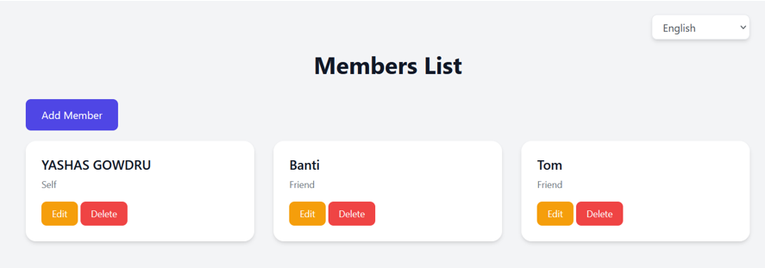
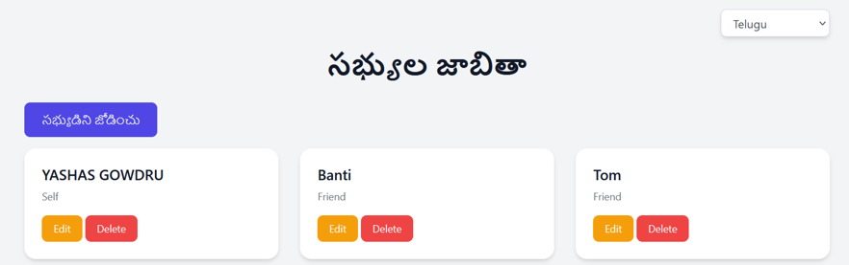
Screenshots

Slide 28
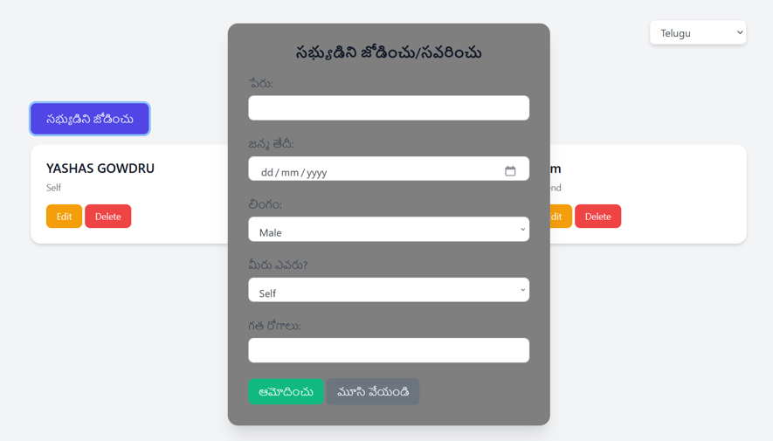
Screenshots

Slide 29
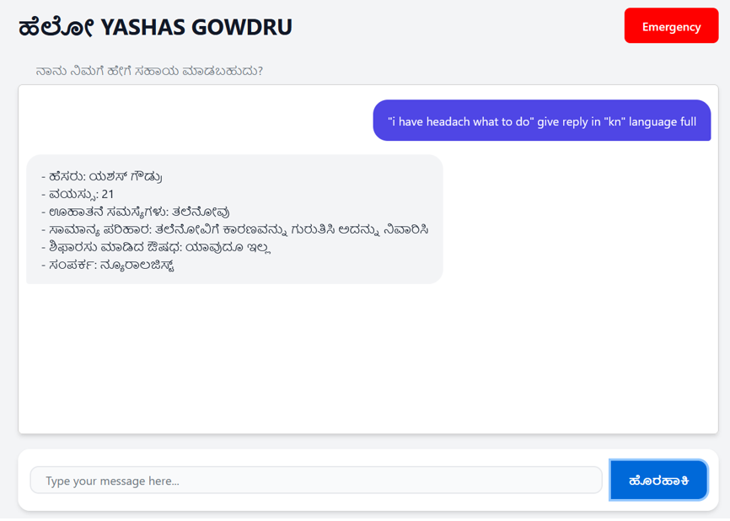
Screenshots

Slide 30
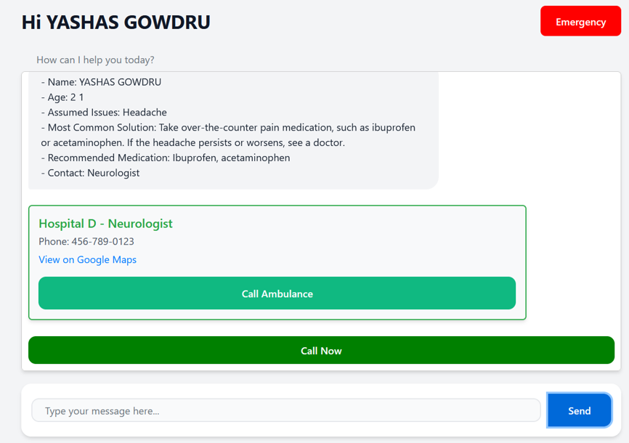
Screenshots

Slide 31
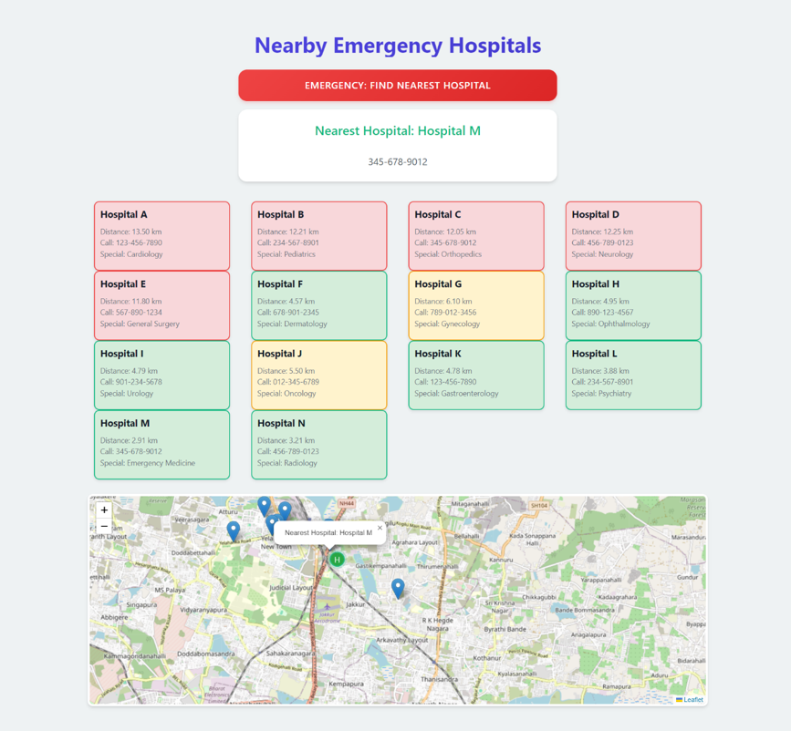
Screenshots

Slide 32
Publication
We have published paper in IJSREM Journal which is UGC care journal.
This is our paper submission link –
https://ijsrem.com/download/ai-driven-progressive-web-application-for-enhancing-emergency-healthcare-decision-making/

Slide 33
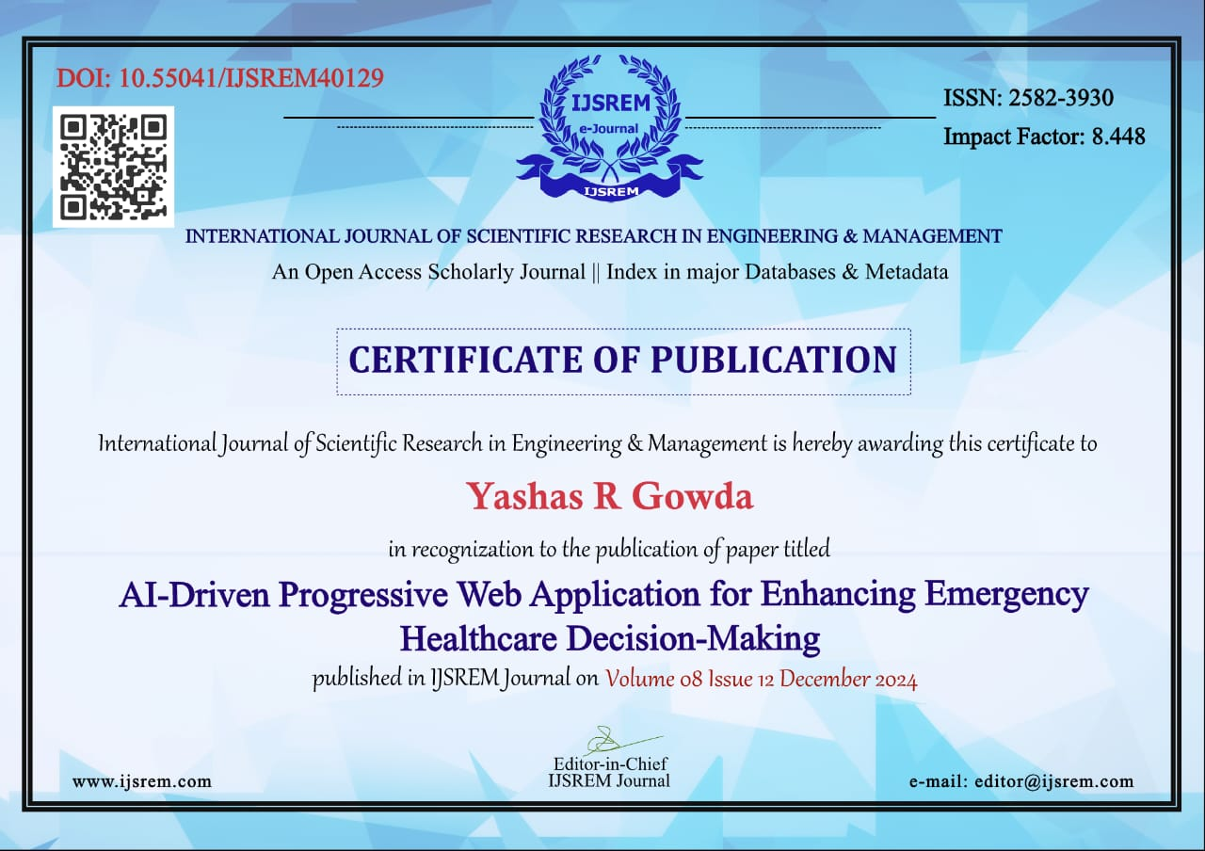
Certificates

Slide 34

Certificates

Slide 35


Slide 36
Thank You

